Slide 1
Programming Refresher​
Notes:
Let's start with a quick refresher on Python programming basics.

Slide 2
Introduction to Python Programming
Notes:
Let's dive into the basics of Python programming.

Slide 3
Install Python and its IDE to set up the programming environment
Use Jupyter Notebook to write and execute Python programs
Write and execute a Python program to perform simple tasks such as printing "Hello World!"
Apply Python identifiers, indentation, and comments to write clear and structured code
Notes:
Read the learning objectives

Slide 4
Business Scenario
ABC Inc. is exploring artificial intelligence projects. The organization is struggling to choose the right programming language for its projects, prioritizing functionality, scalability, efficiency, and developer experience.
After evaluating various options, Python emerged as the ideal choice for all prospective projects because it is simple, secure, scalable, and rich in built-in libraries.
Notes:
Elaborate the business scenarios and discussion in the class

Slide 5
Introduction to Python
Notes:
Let's explore the fundamentals of Python

Slide 6
Python: History
Python is a widely used programming language conceived in the late 1980s.
Python was invented by Guido van Rossum (CWI, Amsterdam).
It is named after the BBC comedy series Monty Python's Flying Circus.
It is now maintained by the Python Software Foundation (PSF).
It is derived from the ABC, Modula-3, Lisp, and C languages.
Notes:
This slide is self explanatory.

Slide 7
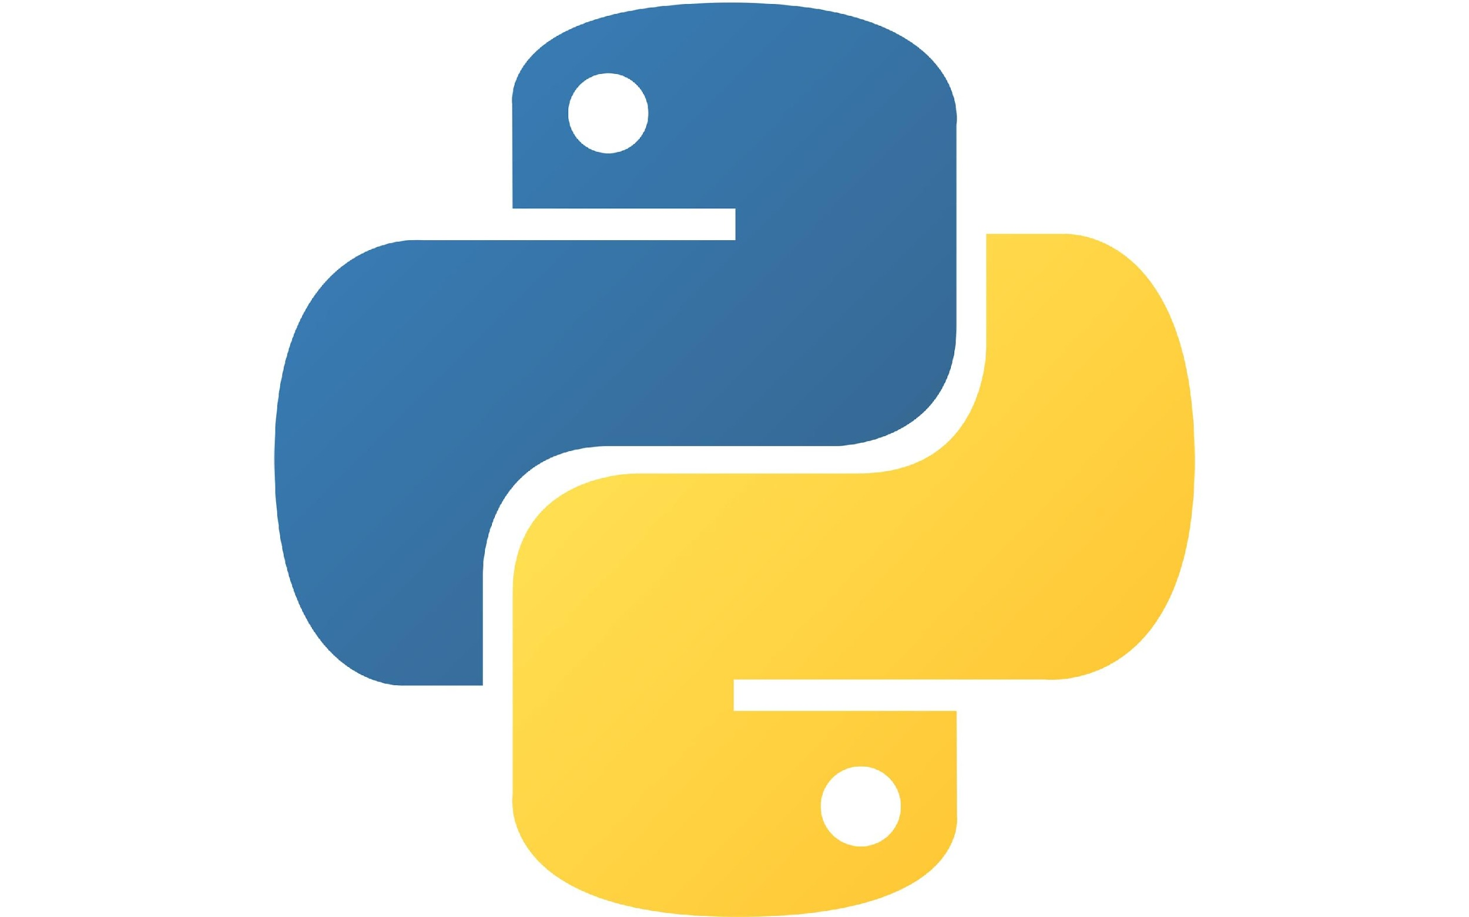
All about Python
Python is a high-level, interpreter-based, object-oriented programming language with dynamic semantics.
It is a simple, general-purpose programming language and can be used for various applications, such as data science and automation.
Python's simple and easy-to-learn syntax emphasizes readability and reduces the cost of program maintenance.
Python supports modules and packages, encouraging program modularity and code reuse.
Python is a free and open-source language.
Notes:
Its high-level built in data structures, combined with dynamic typing and dynamic binding, make it very attractive for Rapid Application Development, as well as for use as a scripting or glue language to connect existing components together.
The Python interpreter and the extensive standard library are available in source or binary form without charge for all major platforms and can be freely distributed.

Slide 8
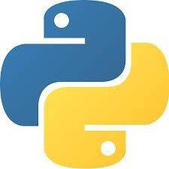
Python: Advantages
Flexible
It aids in the cross-platform compatibility and scripting of web pages and applications.
Easy to learn and use
It uses a minimal amount of code to complete tasks.
Readability and maintenance
Python places a strong emphasis on readable code and permits the use of English keywords in place of punctuation.
Robust standard library
It allows selecting a module from a large selection based on the requirement.
Notes:
This slide is self explanatory.

Slide 9
Python: Technical Strengths
Python has the following strengths which make it user-friendly:
Object-oriented
programming
Supports advanced notions such as polymorphism, operator overloading, and multiple inheritances
Free and open-source
Allows modification and redistribution of the source code
Provides a free license
Can be implemented on every major platform
Can be used with Unix, Linux, MS-DOS, MS Windows, Macintosh, and IBM
Portable
Provides dynamic typing and automatic memory management
Provides built-in objects and tools that consist of libraries and third-party utilities
Powerful
Can be easily glued to components written in other languages
Allows for adding functionality to existing systems
Compatible
Notes:
The standard implementation of Python is written in portable ANSI C, and compiles and runs on virtually every major platform in use today.
Python is available on Unix systems, Linux, MS-DOS, MS Windows, Macintosh, IBM mainframes and many more.

Slide 10
Python: Industrial Use Cases
Python is widely used in the following platforms:
YouTube
Python is one of the key programming languages used in the backend of the YouTube video-sharing system, particularly for data analysis and handling metadata.
Google
Python is being extensively used in Google’s web search system.
Dropbox
The server and client’s software for Dropbox is primarily coded in Python.
Notes:
This slide is self explanatory.

Slide 11
Python: Industrial Use Cases
Python is widely used in the following platforms:
BitTorrent
The peer-to-peer file-sharing system started as a Python program.
Netflix
Python is used throughout the full content life cycle at Netflix.
Notes:
This slide is self explanatory.

Slide 12
Python Installation
Notes:
Let's start with setting up Python on your system.

Slide 13
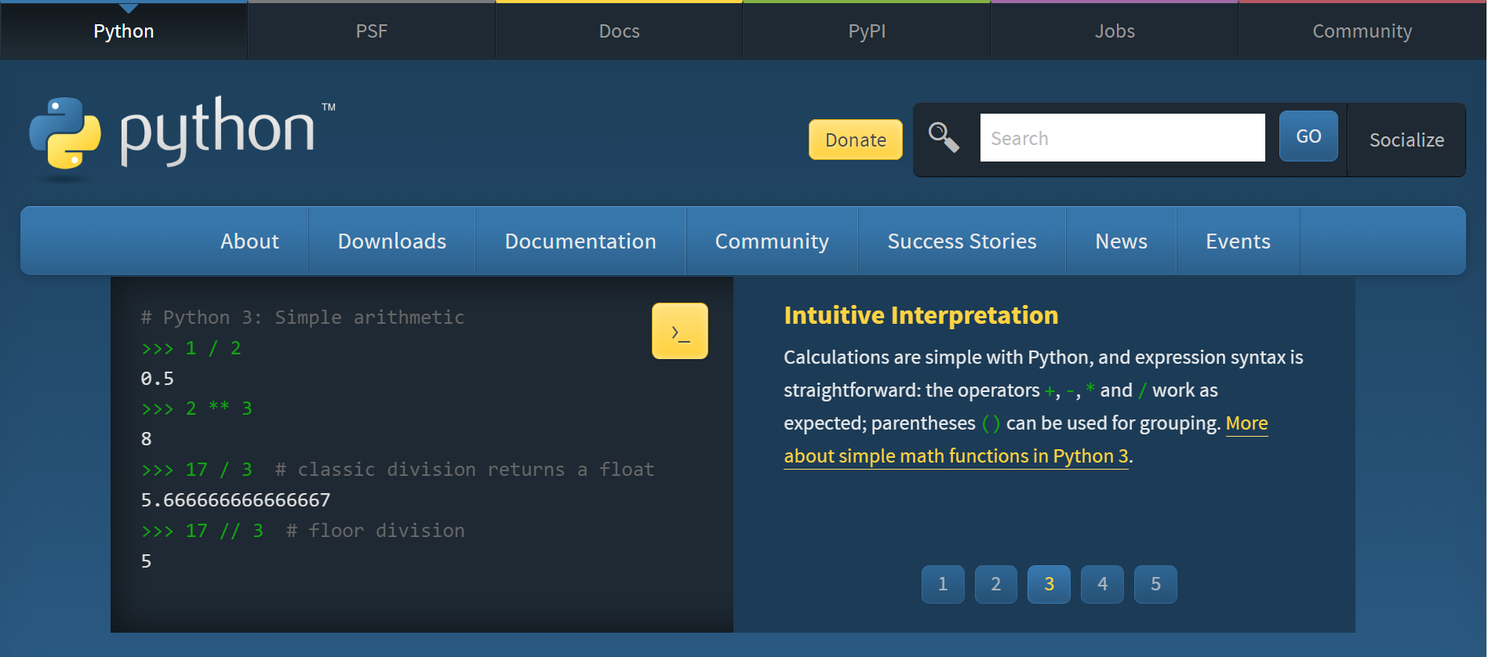
Python: Installation
There are two ways to install Python:
1. Install Python using the URL
Step 1.1: The latest or required version of Python for a specific platform can be installed from the official Python website: https://www.python.org/
Notes:
This slide is self explanatory.

Slide 14
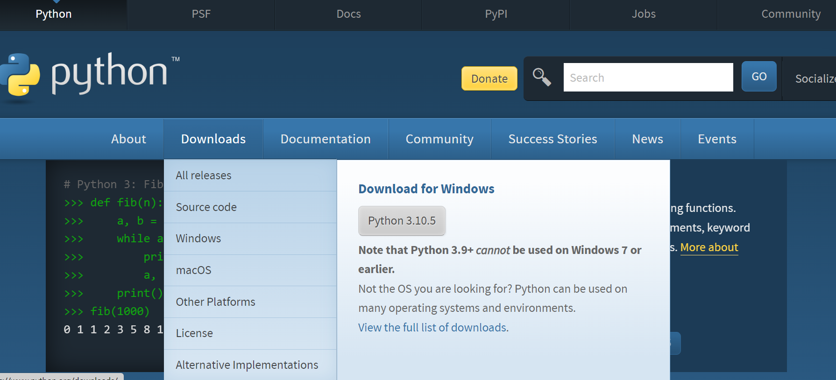
Python: Installation
Step 1.2: Click on the Downloads to download Python
Notes:
This slide is self explanatory.

Slide 15
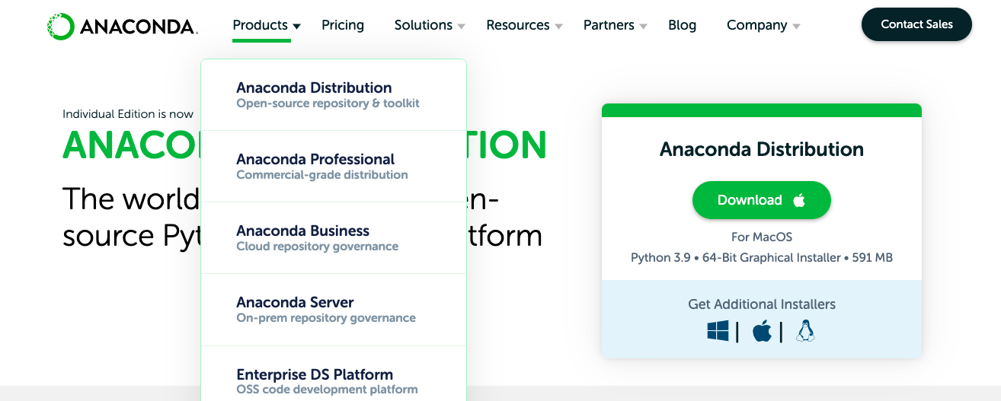
Python: Installation
There are two ways to install Python:
2. Install Python from the Anaconda file distribution system
Step 2.1: Click on the link: https://www.anaconda.com/products/distribution
Specific platform
Recommended
Notes:
This slide is self explanatory.

Slide 16
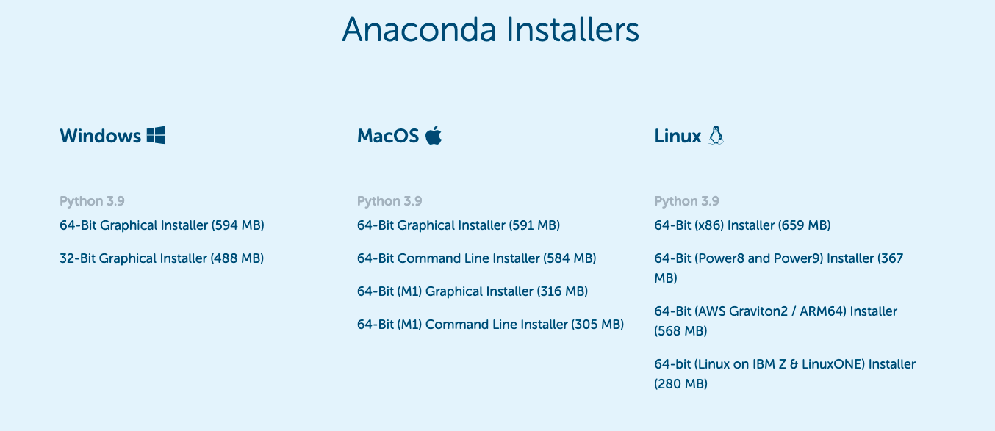
Python: Installation
Step2.2: The Anaconda file distribution system consists of all the different installers; click on the required installer
Notes:
This slide is self explanatory.

Slide 17
Assisted Practice: Installation of Python
Duration: 5 mins
Objective: In this demonstration, you will learn how to install Python.
Tasks to perform:
Log in to the URL to download Python: https://www.python.org/
Click on Downloads to download Python
Notes:
This slide is self explanatory.

Slide 18
Python IDE
Notes:
Let's explore Integrated Development Environments (IDEs) for Python.

Slide 19
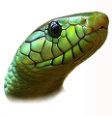








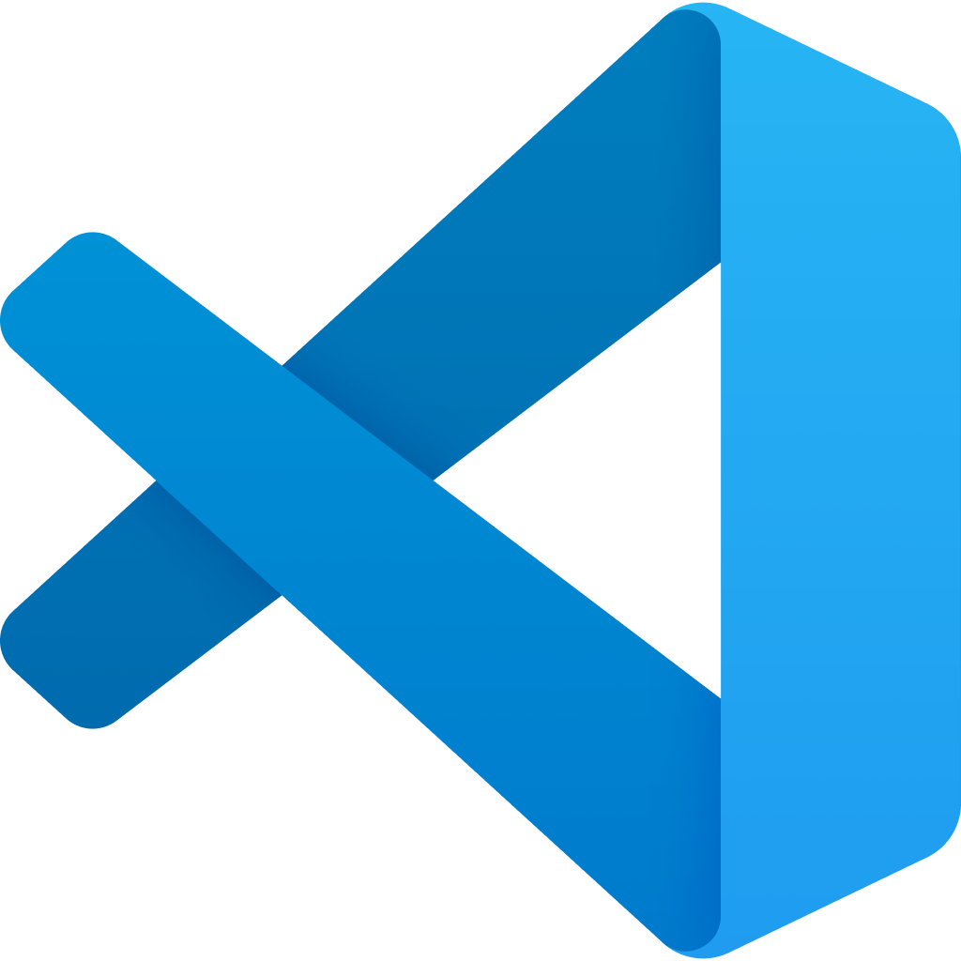
Python IDE
An integrated development environment (IDE) is a software suite that consolidates the basic tools required to write and test software.
Eric
Wing
Atom
PyDev
PyCharm
Jupyter Notebook
Rodeo
Thonny
Spyder
Microsoft VS Code
Notes:
This slide is self explanatory.

Slide 20
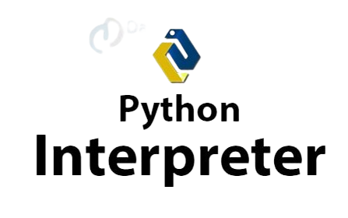
Python: Interpreter
Python code can be written in any text editor and saved using the .py extension in the system.
Python is characterized as a REPL (Read-Eval-Print Loop) language because of the way its interpreter works, it:
Reads the command
Executes the command
Outputs the results
Loops back to read it again (read, evaluate, print, and loop)
Notes:
This slide is self explanatory.

Slide 21
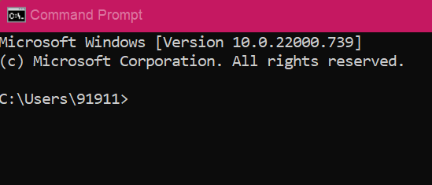
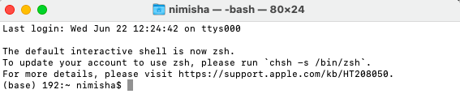
Python: Shell
Python can be accessed through the command prompt on the Windows OS and the terminal window on the Mac OS.
Windows
Mac
Notes:
This slide is self explanatory.

Slide 22
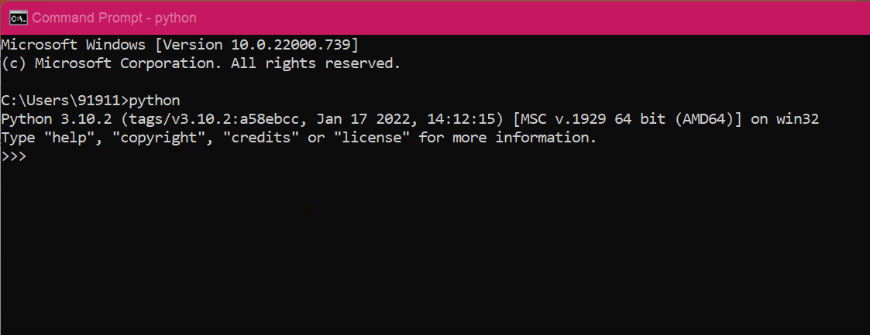
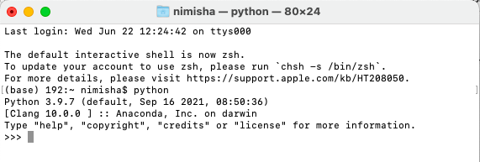
Python: Shell
Type python in your terminal or command prompt to open the Python interactive shell.
Windows
Mac
Notes:
This slide is self explanatory.

Slide 23
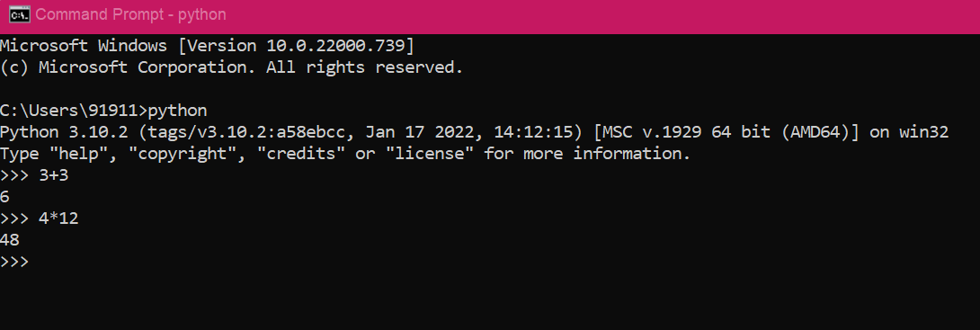
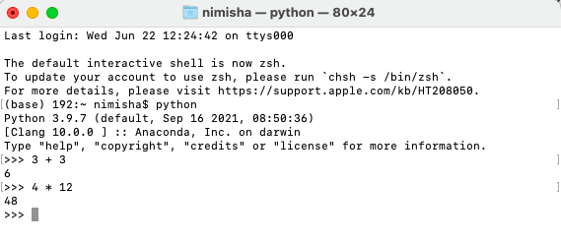
Python: Shell
Enter any statement to get the expected results:
Windows
Mac
Notes:
This slide is self explanatory.

Slide 24
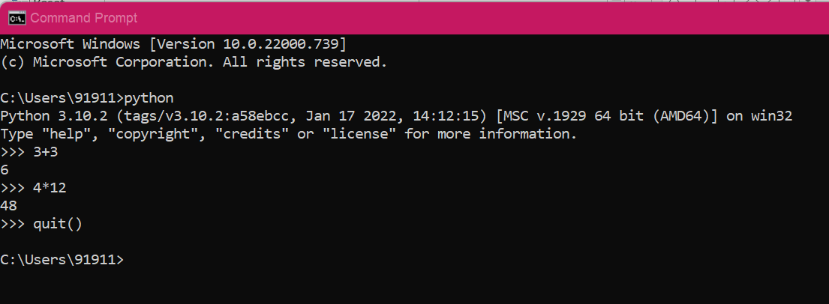
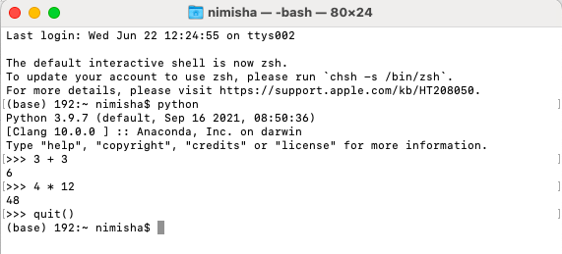
Python: Shell
Enter the quit() command to exit from the environment.
Windows
Mac
Notes:
This slide is self explanatory.

Slide 25
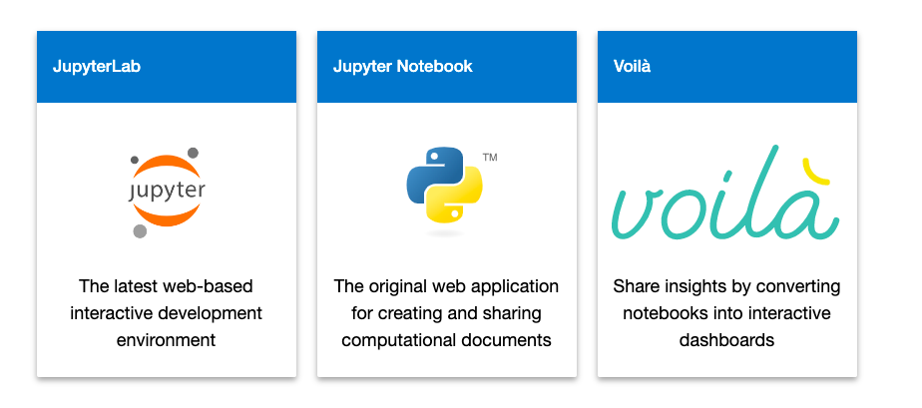
Python: Jupyter
Jupyter is a project and a community to create open-source software, open standards, and services for interactive computing across dozens of programming languages.
Jupyter can be accessed through three main environments:
Image source : https://jupyter.org/try
Notes:
Image source : https://jupyter.org/try
The Jupyter team builds several end-user applications that facilitate interactive computing workflows.

Slide 26
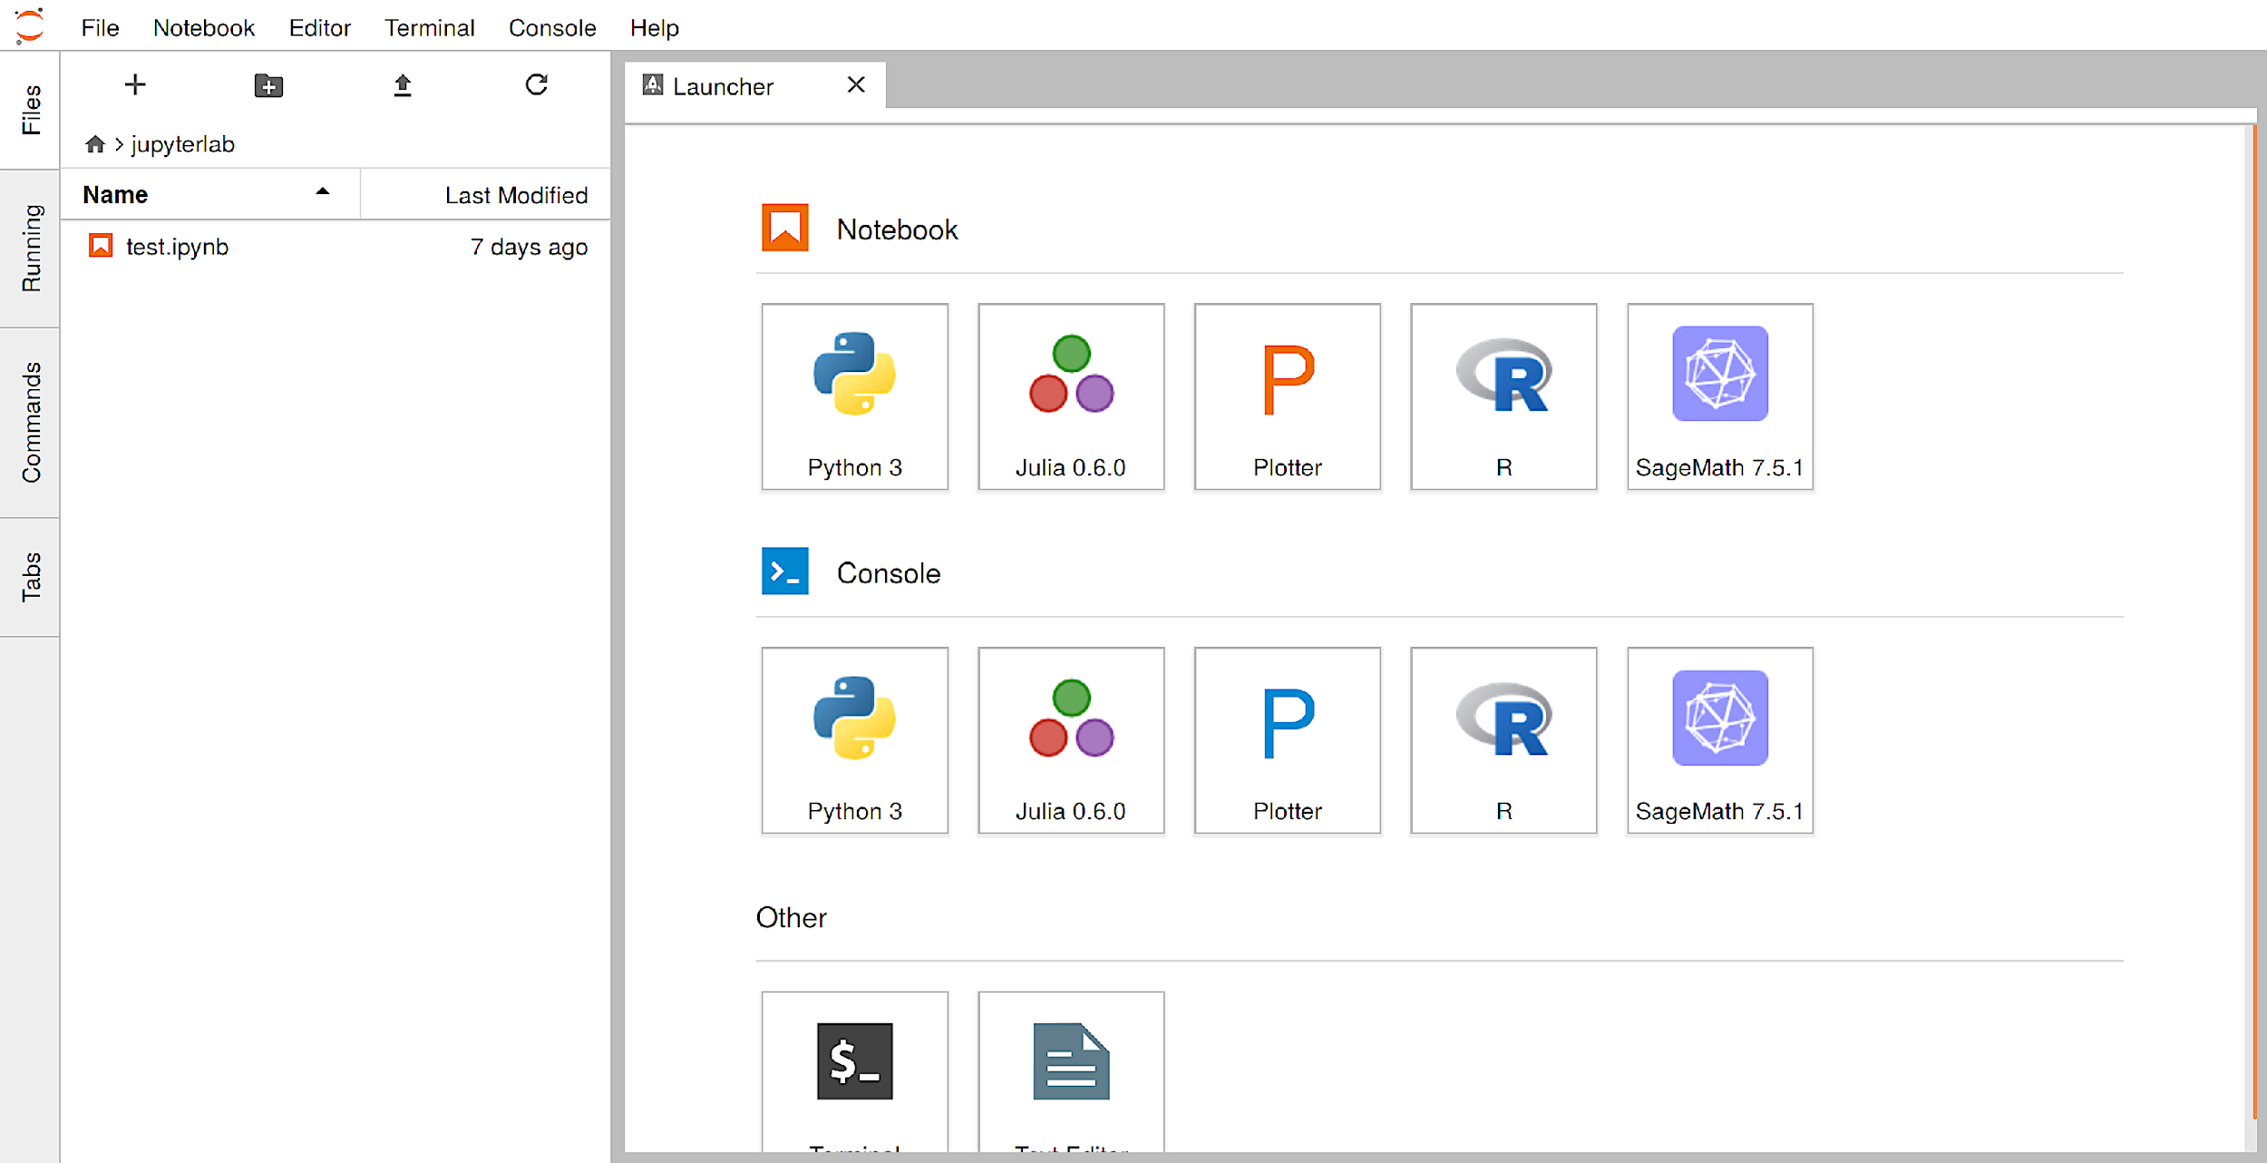
Python: Jupyter Lab
The Jupyter lab can access Python and has the following features:
The most recent web-based interactive development environment for code, data, and notebooks is Jupyter Lab.
Users can configure and arrange workflows in data science, scientific computing, computational journalism, and machine learning using the Jupyter lab.
Notes:
This slide is self explanatory.

Slide 27
Python: Jupyter Lab Installation
Enter the following commands to access the Jupyter Lab:
Step 1: Jupyter Lab can be installed with pip.
pip install jupyterlab
Step 2: Once installed, launch Jupyter Lab with the below command:
jupyter-lab
Notes:
This slide is self explanatory.

Slide 28
First Python Program
Notes:
Let's dive into writing our first Python program.

Slide 29
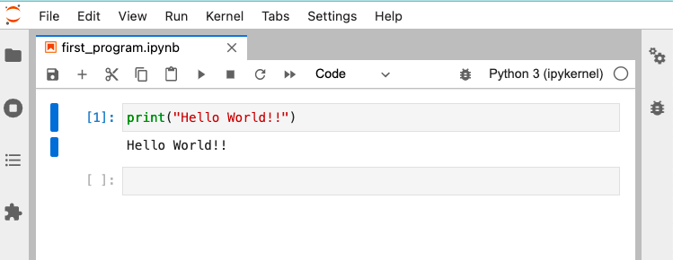
Python: First Program
Here’s a simple Python program to print values:
print() is a built-in function that displays a specified message on the screen.
The message can be:
A string
An integer
Any other object
The object will be converted into a string before being written to the screen.
Notes:
This slide is self explanatory.

Slide 30
Assisted Practice : First Python Program
Objective: In this demonstration, we will learn how to write and execute a simple Python program.
Tasks to perform:
1. Open a new notebook in the Jupyter Lab
2. Write and execute a program to print “Hello World!”
Notes:
This slide is self explanatory.

Slide 31
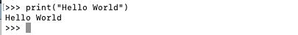
Python: Code Execution
A Python program can be executed in two ways:
1. A Python program can be executed by writing directly on the command line.
2. A Python program can be executed as a batch file, where a Python file is created on a code editor, saved using the .py file extension, and run on the command line.
Notes:
This slide is self explanatory.

Slide 32
Python Programming Features
Notes:
Let’s discover the key features that make Python a powerful and versatile programming language.

Slide 33

Python: Identifier
A Python identifier is a name used to identify a variable, function, class, module, or another object.
There are a few identifier naming rules which are as follows:
Identifiers can be a combination of:
Letters in lowercase (a to z) or uppercase (A to Z)
Digits (0 – 9)
Underscore ( _ )
Special symbols like! @, #, $, % cannot be used in an identifier.
Rules
An identifier cannot start with a digit, and it can be of any length.
Keywords like global and class cannot be used as identifiers.
Python is case-sensitive where a is not equal to A.
Notes:
This slide is self explanatory.

Slide 34
Python: Identifier
Few examples of identifiers are as follows:
Valid identifiers are:
myClass,
var_1,
count
Invalid identifiers are:
1variable,
class@new,
global
Examples
Notes:
This slide is self explanatory.

Slide 35
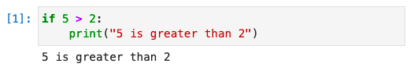
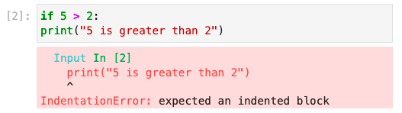
Python: Indentation
Indentation refers to the spaces at the beginning of a code line.
The importance of indentation in Python is provided below:
Correct Syntax
Python's indentation is crucial, unlike in other programming languages, where it makes the code easier to understand.
Python uses indentation to indicate a block of code. For example, for if … else, for loop, and while loop
An indented block of code begins with “:”
Incorrect Syntax
Notes:
The number of spaces is up to you as a programmer, but it has to be at least one.
You have to use the same number of spaces in the same block of code, otherwise Python will give you an error.

Slide 36
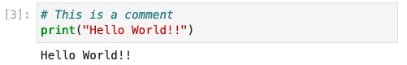
Python: Comments
Comments are programmer-readable explanations in a program.
Example:
Comments are annotations in the source code of a computer program.
Comments make it easier for humans to understand the source code.
A comment in Python starts with #, and the rest of the line is considered a comment.
Notes:
This slide is self explanatory.

Slide 37
Python is an interpreted language, but it is also a powerful programming language with complex data structures and reusable modules.
IDEs such as JupyterLab, Atom, Spyder, and PyCharm are used to access Python.
Python syntax is simple to use, and indentation marks the code block.
Notes:
This slide is self explanatory.

Slide 39
Python was invented by _______.​
1
Guido van Rossum ​
Dennis MacAlistair Ritchie​
James Gosling ​
None of the above​
Notes:
This slide is self explanatory.

Slide 40
Python was invented by _______. ​
1
Guido van Rossum ​
Dennis MacAlistair Ritchie​
James Gosling ​
None of the above​
A​
Python was invented by Guido van Rossum (CWI, Amsterdam.)​
Notes:
This slide is self explanatory.

Slide 41
The advantages of Python are:​
2
Flexible​
Easy to use​
Readability​
All of the above​
Notes:
This slide is self explanatory.

Slide 42
The advantages of Python are:​
2
Flexible
Easy to use​
Readability​
All of the above​
D
Python aids in cross-platform compatibility, uses a minimal amount of code to complete tasks, and places a strong emphasis on readable code.​
Notes:
This slide is self explanatory.

Slide 43
Python code can be written in any text editor and saved using the _____ extension in the system.​
3
.pytxt​
.python​
.py​
All of the above​
Notes:
This slide is self explanatory.

Slide 44
Python code can be written in any text editor and saved using the _____ extension in the system.​
3
.pytxt​
.python​
.py​
All of the above​
C
Python code can be written in any text editor and saved using the .py extension in the system.​
Notes:
This slide is self explanatory.

Slide 45
Thank You!
Notes:
Thank you

